Slide 1
Unit Testing

Slide 2
Contents
Code Refactoring
Unit Testing in various Development Lifecycle Models
Unit Testing in Continuous Integration Environment
Jenkins
Tools Strategy for Unit Testing
TFS Build
MSTS (Microsoft Test suit)

Slide 3
Code Refactoring
Refactoring is a disciplined technique for restructuring an existing body of code, altering its internal structure without changing its external behavior.
Refactoring improves nonfunctional attributes of the software.
Advantages include improved code readability and reduced complexity.
These can improve source-code maintainability and create a more expressive internal architecture or object model to improve extensibility.

Slide 4
Unit Testing in various Development Lifecycle Models
Testing in Waterfall:
Three types of testing typically take place: unit testing of individual code modules; system testing of the integrated product; and acceptance testing, formally conducted by or on behalf of the customer.
Dynamic testing relies on running a defined set of operations on a software build and comparing the actual results to the expected results.
If the expected results are obtained, the test counts as a pass; if anomalous behavior is observed, the test counts as a fail, but it may have succeeded in finding a bug.
Contd…

Slide 5
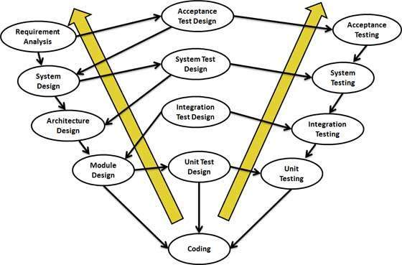
V- Model:
In the V-Model, Unit Test Plans (UTPs) are developed during module design phase. These UTPs are executed to eliminate bugs at code level or unit level.

Slide 6
Agile methodology :
In this methodology, requirement, design, and code changes are part of the process, and accommodating such changes are the basis of Agile.
You will never have complete and unchanging requirements and design documents from the start.
As the requirements and design change, you often have to change all your written unit test cases.
The scrum process is designed to handle changes in requirements coming from the product owner during the development process, so you may need to change the previously written unit code.
In the case of legacy products, the code base continues to increase over time, and changes to it can result in broken code. To confirm that the new development hasn’t broken the legacy code, you will need to do regression testing using your unit tests.

Slide 7
Unit Testing in Continuous Integration Environment
Continuous Integration (CI) is a development practice that requires developers to integrate code into a shared repository several times a day.
Each check-in is then verified by an automated build, allowing teams to detect problems early.
By integrating regularly, you can detect errors quickly, and locate them more easily.

Slide 8
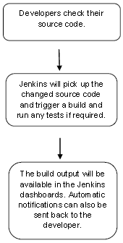
Jenkins
Jenkins is a powerful application that allows continuous integration and continuous delivery of projects, regardless of the platform you are working on.
It is a free source that can handle any kind of build or continuous integration.
You can integrate Jenkins with a number of testing and deployment technologies.

Slide 9
NUnit Testing
As we discussed earlier, NUnit is a unit-testing framework for .NET applications in which the entire application is isolated into diverse modules.

Slide 10
TFS Build
Team Foundation Build provides the functionality of a public build lab and is part of Visual Studio Team Foundation Server.
With Team Foundation Build, enterprise build managers can synchronize the sources, compile the application, run associated unit tests, perform code analysis, release builds on a file server, and publish build reports.
Team Foundation Build works with other Team System tools during the build process, including source control, work item tracking, and with test tools.
Team Foundation Build:
Build Type Provides an interface which lets the user define the build steps and build parameters needed for their builds.
Build Execution Leverages the build type to build the product and generate build outputs. It runs all build steps including execution of test code, updates work items, and calculates build metrics.
Build Report Provides a view into the execution of the build. The report lists the overall build status including detailed build steps, work items resolved, code changes, and summary of test execution. The build reports are viewable from Team Build Browser.

Slide 11
TFS Build(Source Control)
There are two primary types of roles that use Team Foundation source control.
Contributor A contributor is a user of Team Foundation source control who is primarily concerned with adding, deleting, and modifying files in the source control server.
A contributor will use Team Foundation source control to:
Retrieve files from the source control server.
Check out files for modification.
Check in modified files.
Add files to the source control server.
Delete files from the source control server.
Compare files.
Merge changes between files.

Slide 12
Administrator The second role is an administrator who is concerned more with the administration of the source control server and the use of the files that it contains for creating a reproducible software build. An administrator is responsible for maintaining the integrity of data stored in the software configuration management system. This task differs based on a particular system; however it usually involves managing access to the source control server and enforcing a backup policy for data that it contains.
An administrator will use Team Foundation source control to:
Branch code files in the source control server.
Label a snapshot of the current development state.
Merge changes between source control server branches.

Slide 13
Configuration Manager :
You can store different configurations of solution and project properties to use in different kinds of builds.
To create, select, modify, or delete a configuration, you can use the Configuration Manager.
Solution Configurations :
A solution configuration specifies how projects in the solution are to be built and deployed. To modify a solution configuration or define a new one, in the Configuration Manager, under Active solution configuration, choose Edit or New.
Project Configurations :
The configuration and platform that a project targets are used together to specify the properties to use when it's built. A project can have a different set of property definitions for each combination of configuration and platform. To modify the properties of a project, you can use its Property Pages. (In Solution Explorer, open the shortcut menu for the project and then choose Properties.)

Slide 14
MSTS (Microsoft Test suit)
MTM stores Our test plans and results on Team Foundation Server (TFS).
If you don’t need all the features of Microsoft Test Manager, you can use the web portal to plan and run your tests.
The web portal lets you create test cases and organize them into test plans and suites. When you perform a test, the web portal displays the test steps and lets you mark which steps passed or failed.
In addition, Microsoft Test Manager can record your actions, screenshots, Intellitrace logs and other diagnostic data. It also lets you manage lab environments.
But you don’t have to decide upfront - you can always use either tool to edit your test plans or run your tests.

Slide 15


